Slide 1
Race, reading, & youth

Slide 2
Who We Are:
Zia Meyer
L’Oréal Snell
Angela Wiley
We would also like to acknowledge the work of Brittany Thurman and Camden Yandel on this workshop.

Slide 3
Why We're Doing This Work
67% of PPS Students are non-white (53% African American and 14% "other races")
#1 District Goal for PPS is to increase proficiency in literacy for all students
#4 District Goal is to eliminate racial disparity in achievement levels of African-American students
Reports show that when students have positive racial identity, they perform better in academic spaces
Students who do not read during summer vacation loose an average of one month of academic progress over the summer*
http://www.readingrockets.org/article/summer-reading-loss

Slide 4
True or False?
The books I read as a child represented my identities and experiences.

Slide 5
Post-it Note Questions

Slide 6
People of color make up what percent of the US population?

Slide 7
People of color make up what percent of the US population?
38.8%
Source: U.S. Census Quick Facts Estimate https://www.census.gov/quickfacts/fact/table/US/PST045218

Slide 8
What percent of children’s books published in 2018 were about People of Color?

Slide 9
What percent of children’s books published in 2018 were about People of Color?
27%
Source: Cooperative Children's Book Center https://ccbc.education.wisc.edu/books/pcstats.asp

Slide 10
What percent of children’s books published in 2018 were by Black, Latino, and Native Authors (combined?)

Slide 11
What percent of children’s books published in 2018 were by Black, Latino, and Native Authors (combined?)
12.2%
Source: Cooperative Children's Book Center https://ccbc.education.wisc.edu/books/pcstats.asp

Slide 12
At what age do children start to notice race?

Slide 13
At what age do children start to notice race?
3 months
Source: PRIDE Report https://www.racepride.pitt.edu/

Slide 14
Post-It Q&A
*Collected by the Cooperative Children’s Book Center (CCBC)
People of color make up what percent of the US population?
37%
What percent of children’s books published in 2018 were about People of Color?
27%*
What percent of children’s books published in 2018 were by Black, Latino, and Native Authors (combined?)
12.2%*
3 months
At what age do children start to notice race?

Slide 15
Community Engagement
How do we make sure that the books and activities that we bring to an event or program are reflective of the community?
Is the library a part of the gentrification of the neighborhoods or
Does it intersect in the neighborhoods with underserved populations: the homeless, LGBTQIA+, elderly, disabled and Black women and children?

Slide 16
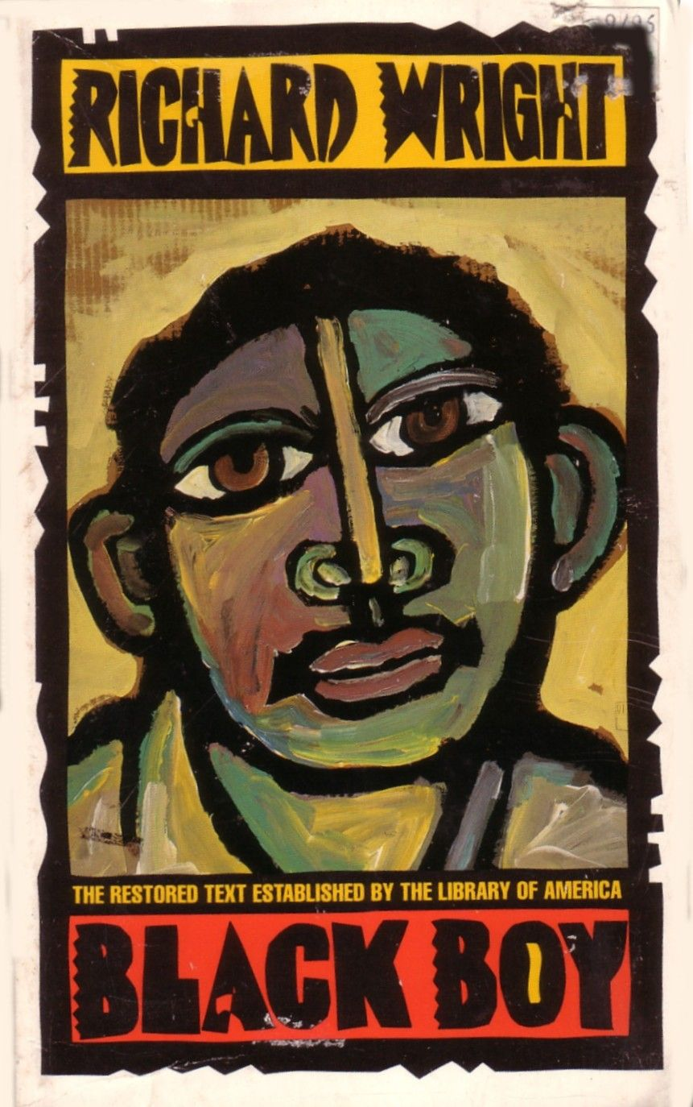
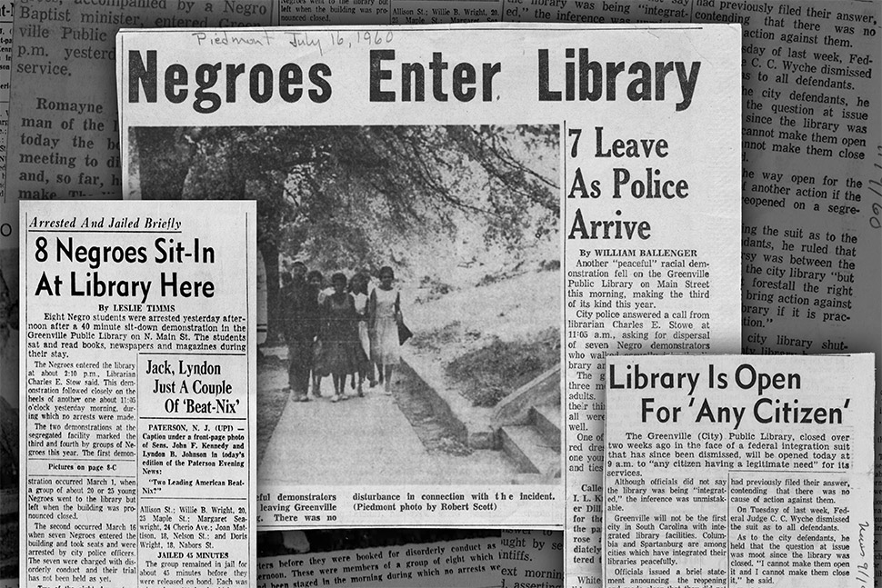
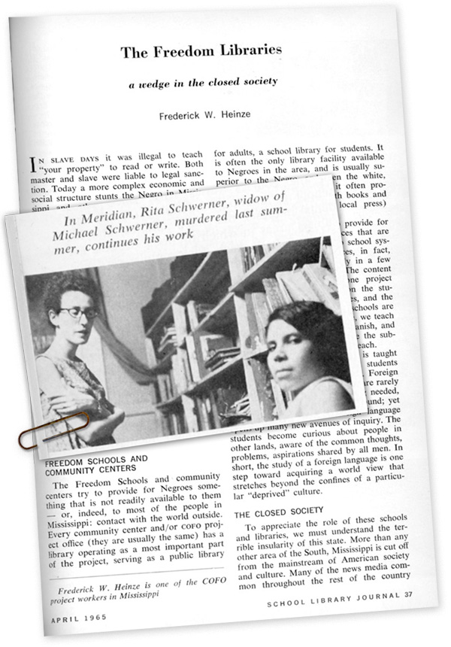
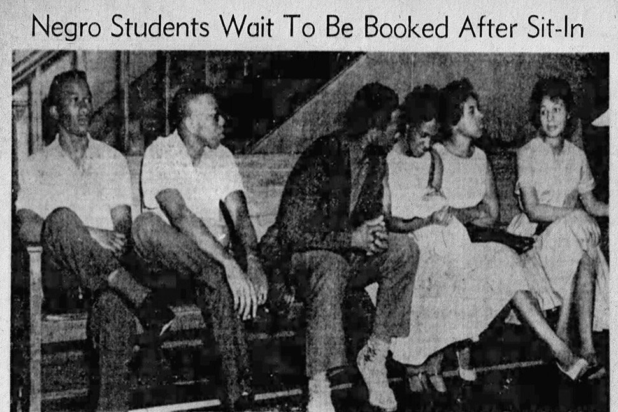
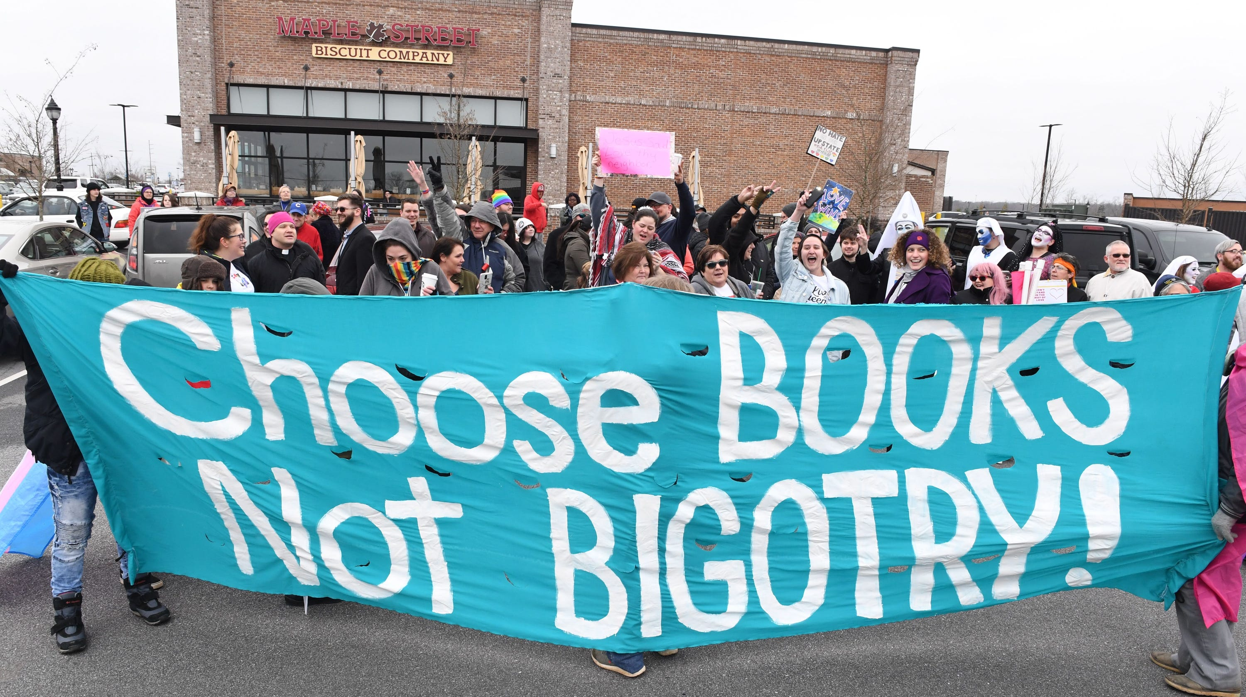
Community Engagement
Black Boy by Richard Wright
Freedom Libraries
Greenville
Drag Queen Story Hour

Slide 17
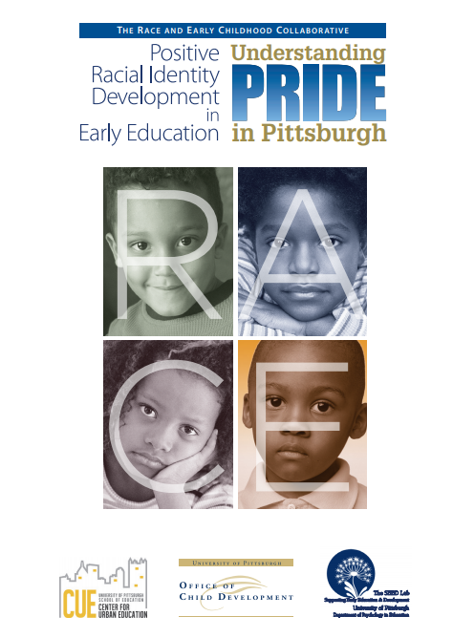
Center for Urban Education
Office of Child Development
Supporting Early Education Development (SEED) Lab
Goals: determine if and how parents and teachers discuss race with young children, determine developmental issues related to positive racial identity, and generate recommendations

Slide 18
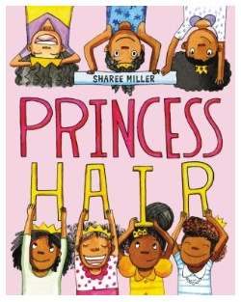
PRIDE Report
Positive racial identity = a positive attitude and belief about one's racial group

Slide 19
PRIDE Report
65% of respondent parents said their children were talking about race
100% of the African American parents said their children were talking about race
Grown-ups said talking about race is important, but they don't know how

Slide 20
Your Turn! Book Exploration

Slide 21
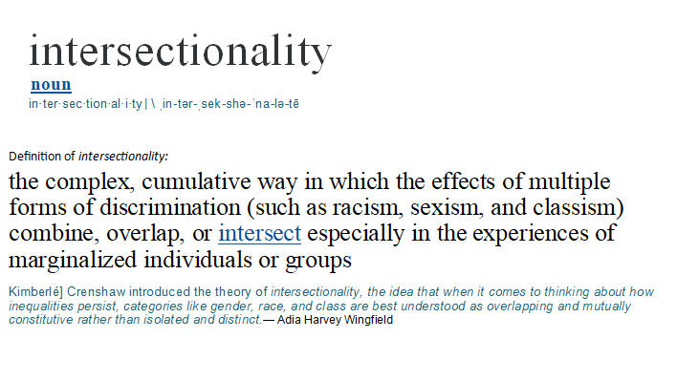

Slide 22
Book Exploration Questions
What is the first thing you noticed about your book?
What made you choose that book?
Is your book intersectional?
Is your book an own voice book?
Does it matter if a book is intersectional and/or own voice if you (or a child) simply enjoy the story?
Notes:
Transitions bring in one question at a time

Slide 23
Diversity, Representation, and the Importance of Own Voice Authors

Slide 24
Things to Be Aware Of
Brown washing: Drawing a fictional character to be racially ambiguously brown for aesthetics or diversity
Realistic fiction about police brutality and violence, dangerous neighborhoods, and traumatic life experiences
Biographies, nonfiction, and historical fiction about slavery, civil rights, and athletes
Children of color are vastly underrepresented in every other genre (science fiction, fantasy, graphic novels, etc.)
Notes:
Transitions bring in one question at a time

Slide 25
Own Voice
A book that features a diverse character that is written by an author of that same diverse background, particularly those from marginalized groups.
"Even when portrayals of diverse characters by majority-group authors are respectfully and accurately done, there’s an extra degree of nuance and authority that comes with writing from lived experience. Those books that are #OwnVoices have an added richness to them precisely because the author shares an identity with the character. The author has the deepest possible understanding of the intricacies, the joys, the difficulties, the pride, the frustration, and every other possible facet of that particular life — because the author has actually lived it."
SOURCE:https://bluecrowpublishing.com/2018/03/30/what-does-ownvoices-mean/

Slide 26
Diversity and Representation through Windows, Mirrors and Sliding Glass Doors
"Books are sometimes windows, offering views of worlds that may be real or imagined, familiar or strange. These windows are also sliding glass doors, and readers have only to walk through in imagination to become part of whatever world has been created and recreated by the author. When lighting conditions are just right, however, a window can also be a mirror. Literature transforms human experience and reflects it back to us, and in that reflection, we can see our own lives and experiences as part of the larger human experience. Reading, then, becomes a means of self-affirmation, and readers often seek their mirrors in books.”
-Rudine Simms Bishop

Slide 27
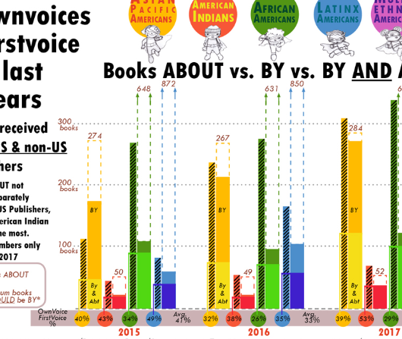
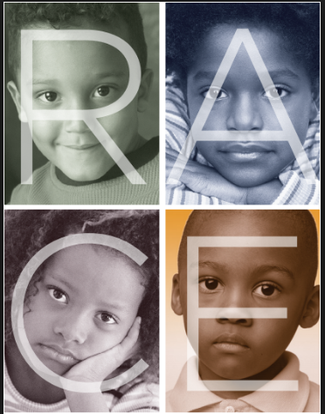
Applications
Insert your organization here!

Slide 28
Diversity Audit

Slide 29
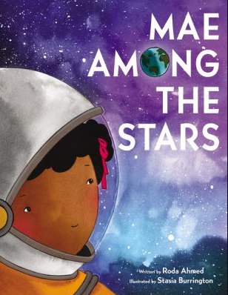
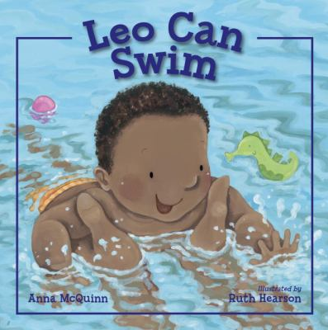
Collection Evaluation

Slide 30
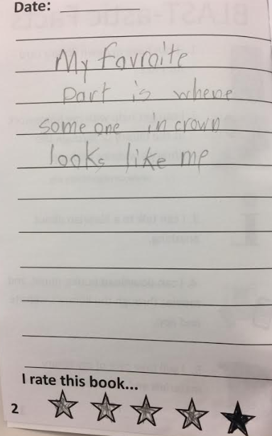
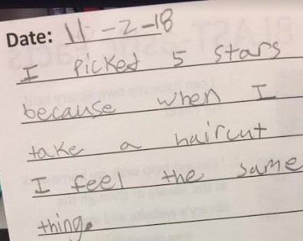
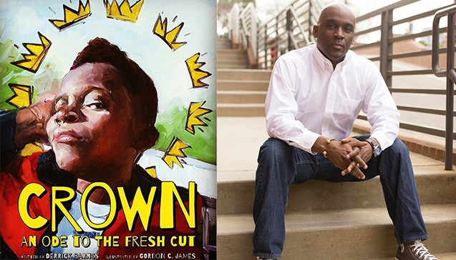
What This Looks Like in Practice
-3rd grader at PPS Concord
-3rd grader at PPS Weil
https://abookandahug.com/crown-ode-fresh-cut/
"I liked the content of the books that were selected. I appreciated that they were culturally relevant to my students."
- 3rd grade teacher at PPS Weil
Notes:
* Feedback from Crown and Where's Rodney
* A teacher inviting a 5th grade student who had been bullied for wearing her hijab in 3rd grade into her classroom to listen to Malala's Magic Pencil
*

Slide 31
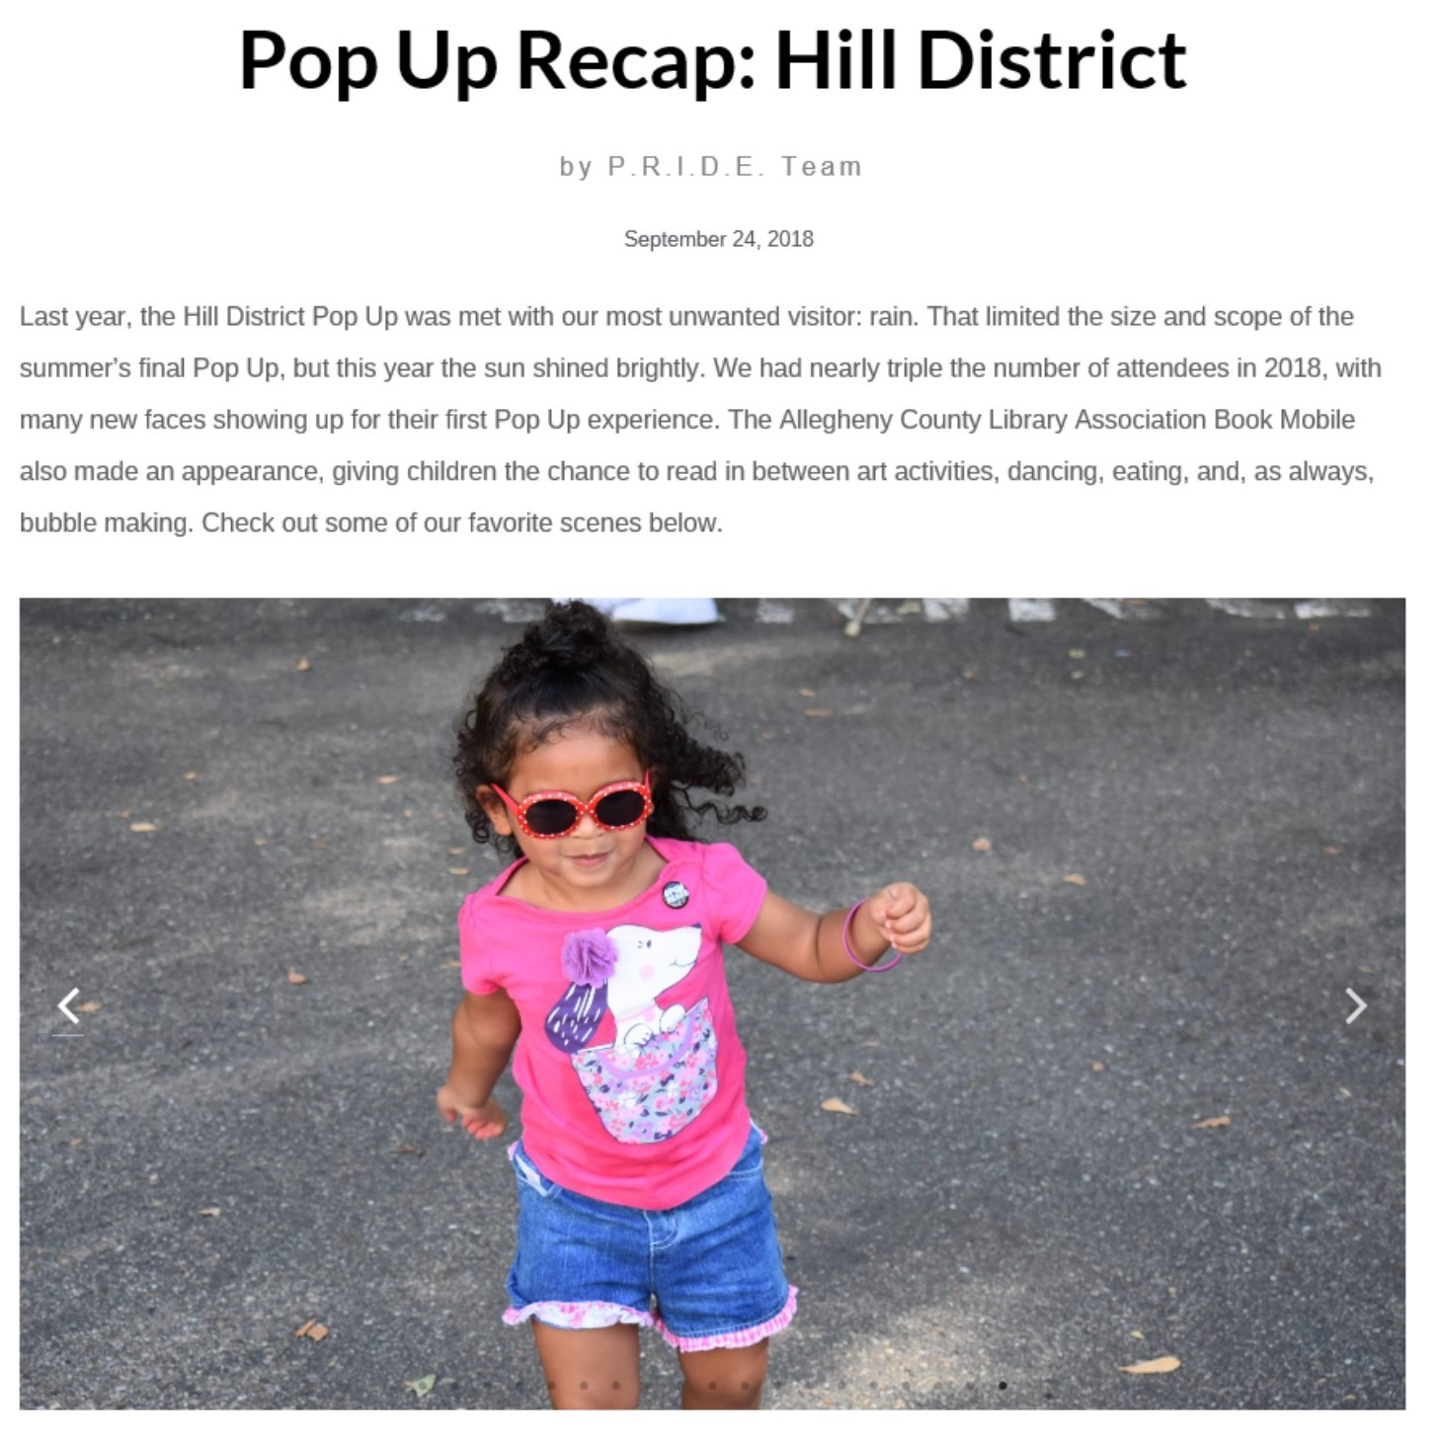
P.R.I.D.E. Pop Up Mini Art Festivals
Currently held in the East Liberty, Homewood, and Hill District neighborhoods of Pittsburgh, the P.R.I.D.E. Pop Ups are one of the only festivals in the United States with programming designed specifically to young Black children aged 3 to 8.

Slide 32
Questions?

