Slide 1
Encouraging Healthy Habits in After-School
Kristi Burry MPH,CHES,CPH
Manager, Health and Prevention, Community Health Division
September 20, 2019

Slide 2
Agenda
Welcome
Review nutrition and physical activity basics
Strategies for promoting healthy behaviors
Action planning

Slide 3
Why is health important to YOU?
Notes:
Have everyone pair up and share with their neighbor OR do fitness trail activity card

Slide 4

Children’s Hospital Community Health
We envision all children growing into
healthy and thriving adults.
Mission:
Work together with hospital, other healthcare, and community partners to improve health outcomes, reduce health disparities, and elevate quality of life for children and families in the communities we serve.
Core efforts guided by Community Health Needs Assessment.
Notes:
Our vision in community health is for all children to graduate high school on time - healthy and thriving. A vision we can all stand behind.

Slide 5
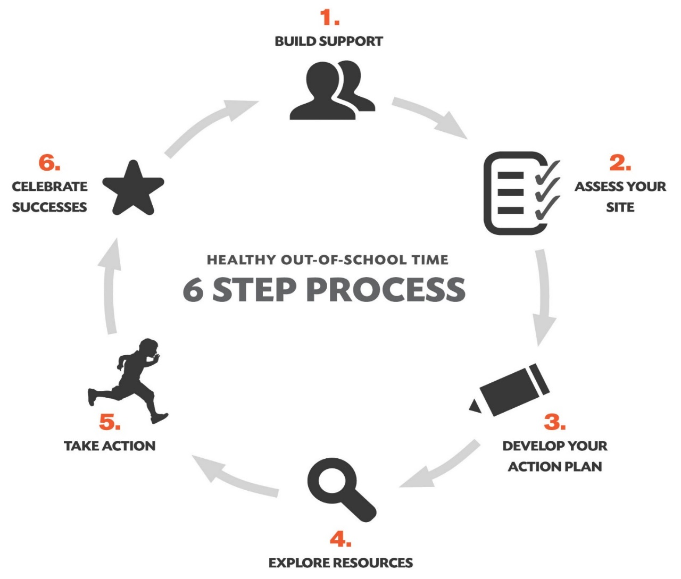
Healthy Out-of-School Time (HOST)
Partnership between Alliance for a Healthier Generation, Children’s Hospital, and United Way’s APOST
Providers evidence-based framework, tools, and resources to support creation of healthy environments for youth in OST
CHP and APOST provide one-on-one technical assistance to all sites participating in HOST

Slide 6
Benefit of Becoming HOST Site
Programs & Resources
Healthy Helper Awards
Professional Development and Education
Community Partner Engagement
Notes:
B

Slide 7














Notes:
WE WORK WITH DOZENS OF COMMUNITY PARTNERS, AND THESE ARE A FEW

Slide 8
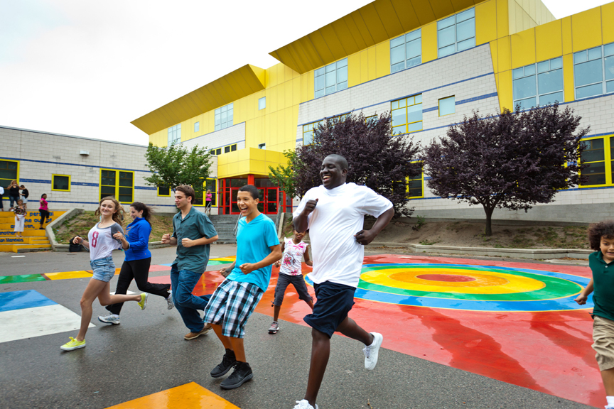
Why Important to Support Health in OST
>10.2 million kids participate in OST programs every year
More flexible environment
Research shows a strong link between a young person’s practice of healthy habits, including a good diet and regular physical activity, and an improvement in their overall life outcomes.

Slide 9

Healthy Eating Guidelines
Source: ChooseMyPlate.gov
Notes:
40% of daily calories coming from added sugars and solid fats
Fruit intake has increased from 2003 to 2010

Slide 10
Benefits of
Healthy Eating
Better grades
More focus, attention & memory
Better attendance
Better behavior
Reduces risk of obesity and chronic disease
Hydration linked to improved cognitive function

Slide 11
Physical Activity Guidelines
Youth
  60+ minutes/day aerobic activity
  3 days/week of bone/muscle strengthening activity
Adults
  Minimum 150 minutes/week
  2 days/week of muscle strengthening activity
Source: Centers for Disease Control and Prevention

Slide 12
Benefits of
Physical Activity
Better behavior
Better concentration & memory
Improved confidence, self-regulation, & motivation
Improved mental health
Builds and maintains healthy bones and muscles

Slide 13
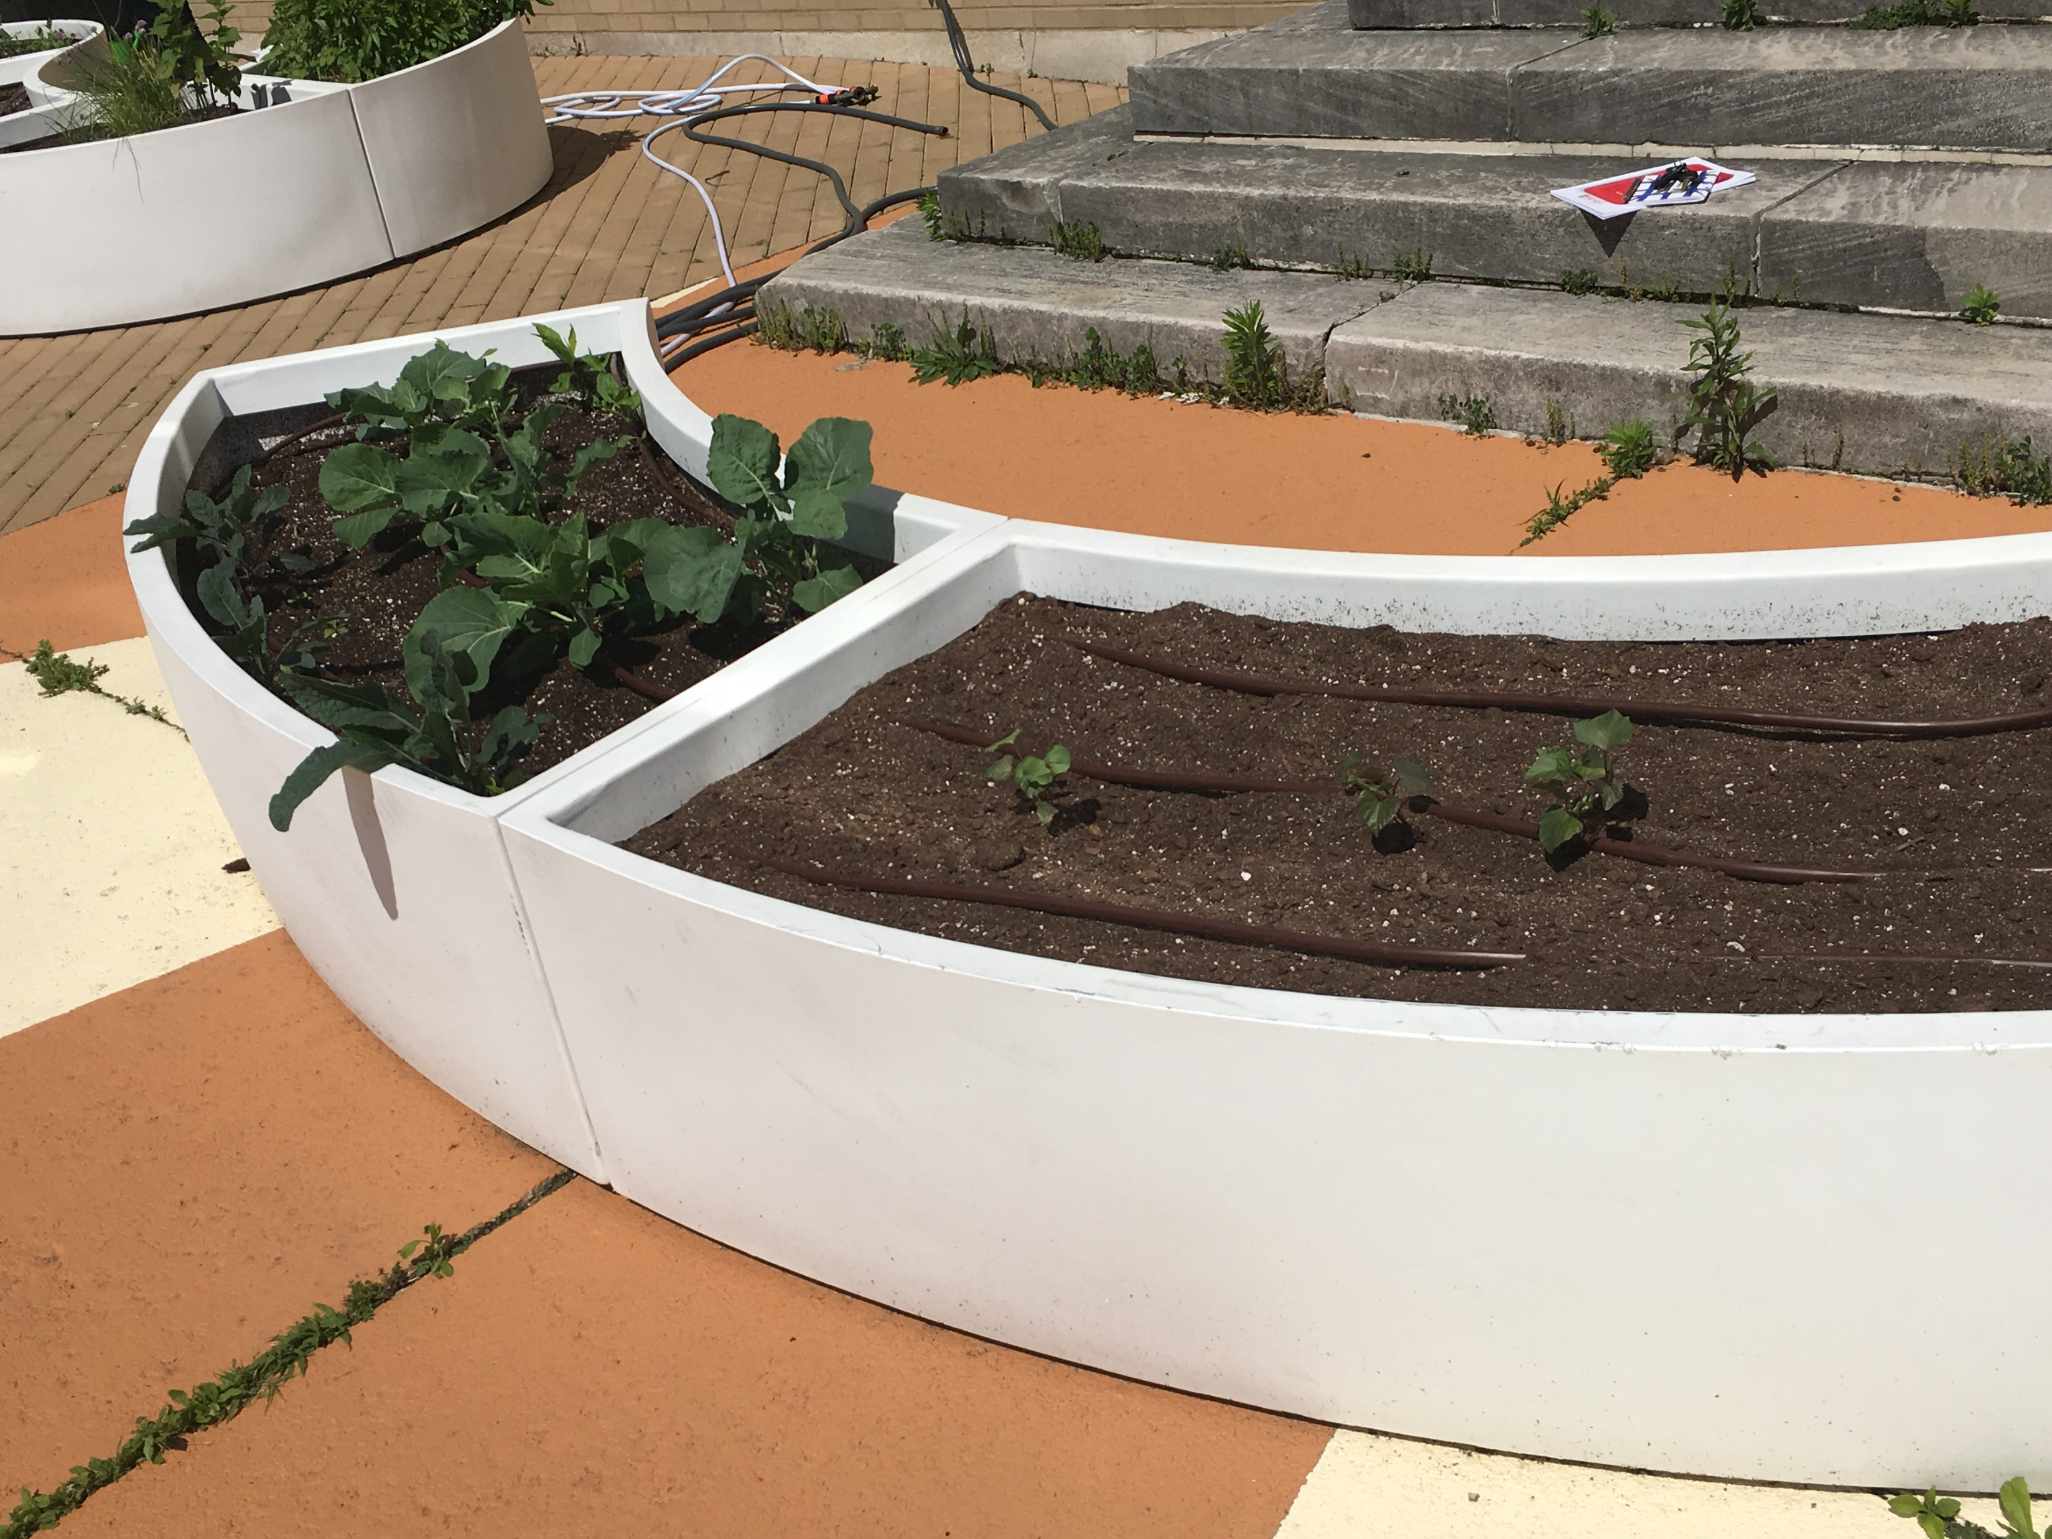
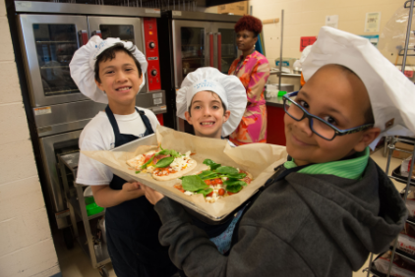
How are you supporting student’s health?
Notes:
-Solicit feedback on what sites are already doing:
- Nutrition: do you serve snacks/meals; following nutrition guidelines; creating healthy eating policy; do staff encourage eating of healthy foods and/or eat meals with youth
- Physical activity: do you have space for physical activity; how much are you doing; do staff engage in physical activity with youth

Slide 14
Strategies to Support Healthy Students
Healthy Rewards & Celebrations
Brain Breaks
Healthy Beverages
Staff Wellness

Slide 15
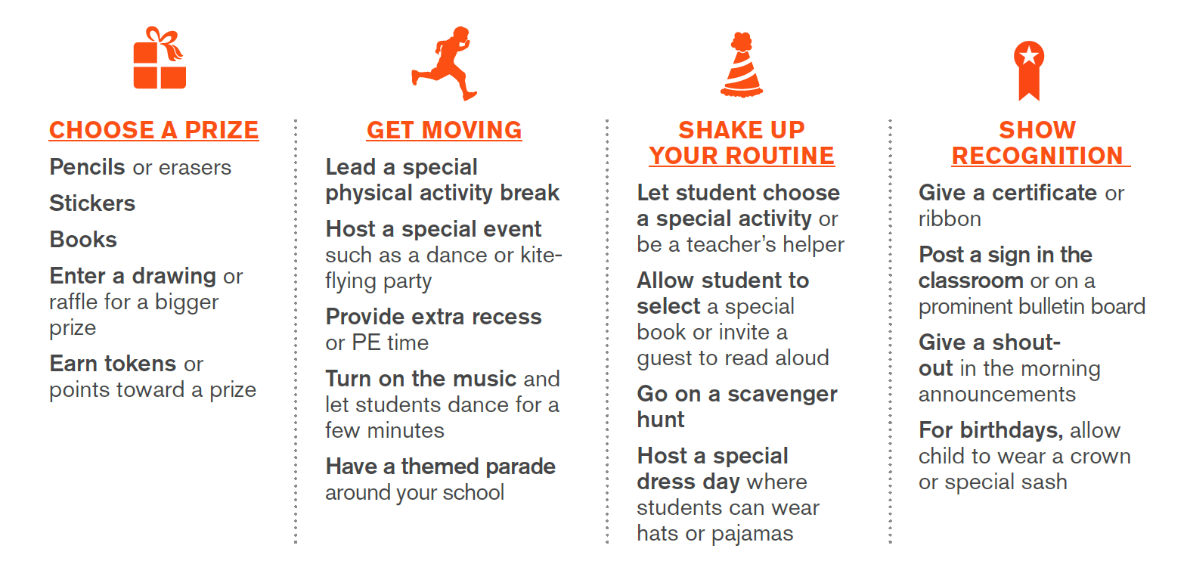
Healthy Rewards & Celebrations
Source: Alliance for a Healthier Generation – Celebrations That Support Child Health
Notes:
https://www.healthiergeneration.org/sites/default/files/documents/20180918/e4ef1c49/HSP%20Healthy%20Celebration%20Guide.pdf

Slide 16
Brain Breaks
Short bursts of activity that provide a mental break
Help students maintain focus and concentration
When to incorporate brain breaks:
    Getting the attention of a group of students
    Transitioning from one activity to the next
    Breaking up longer periods of time spent on one activity
    Beginning or end of program
Notes:
BN

Slide 17
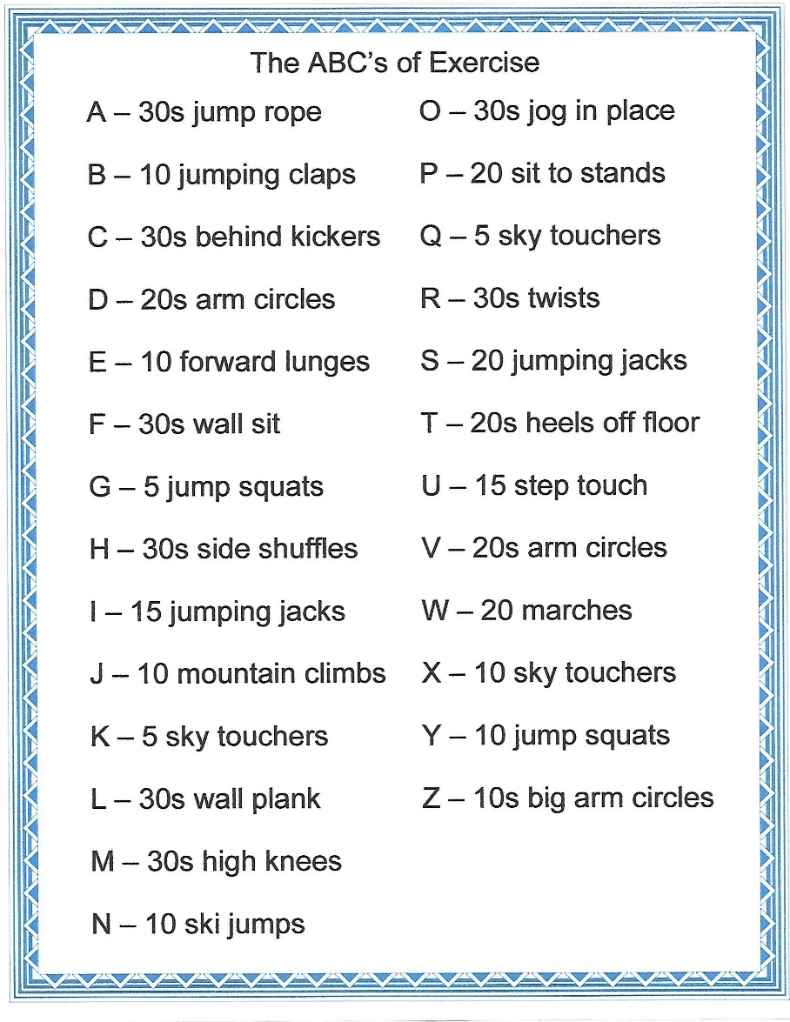

Brain Breaks
Notes:
BN
https://www.healthiergeneration.org/_asset/6jsshc/16-0018_ClssrmPAHandout.pdf
https://www.healthiergeneration.org/_asset/590hh0/10-1819_SecondaryClassroomPA.pdf
https://www.healthiergeneration.org/_asset/p1nfy5/16-0016_PhysActivBrks.pdf

Slide 18
Kid Yoga
Notes:
JF
https://www.healthiergeneration.org/_asset/6jsshc/16-0018_ClssrmPAHandout.pdf
https://www.healthiergeneration.org/_asset/590hh0/10-1819_SecondaryClassroomPA.pdf
https://www.healthiergeneration.org/_asset/p1nfy5/16-0016_PhysActivBrks.pdf

Slide 19

Deck of Cards
10 – Ten jumping jacks
9 – Jump an imaginary rope nine times
8 – Eight mountain climbers (four each leg)
7 – Seven seconds of fast feet
6 – Standing or jumping high knees (three on each leg)
5 – Five calf raises
4 – Four butt kicks (two on each leg)
3 – Hop on one foot three times
2 – Spin around in a circle twice
1 – Complete one modified burpee (walk down, walk feet back, come back up, jump)
ACE – Everyone runs to the wall, touches it, and returns to their seat
Only use cards One through Ten and the Ace card.
Each student selects a card.
Each card is linked with a physical activity.
Notes:
BN

Slide 20
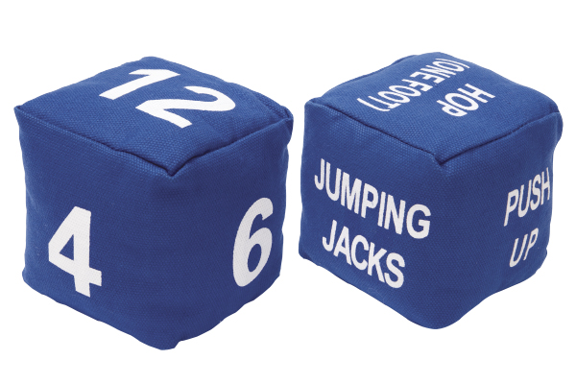
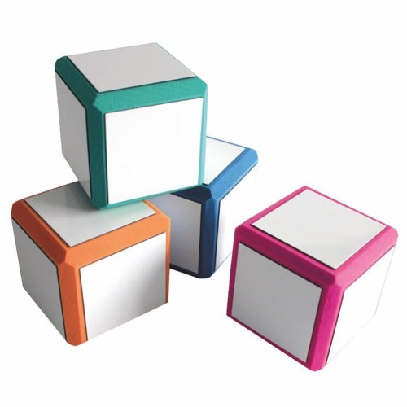
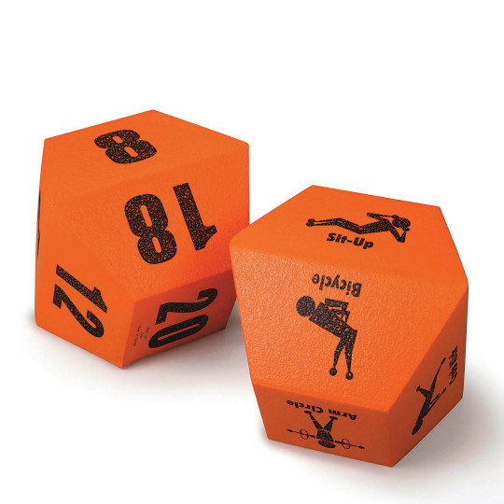
Fitness Dice
Notes:
JF
https://www.healthiergeneration.org/_asset/6jsshc/16-0018_ClssrmPAHandout.pdf
https://www.healthiergeneration.org/_asset/590hh0/10-1819_SecondaryClassroomPA.pdf
https://www.healthiergeneration.org/_asset/p1nfy5/16-0016_PhysActivBrks.pdf

Slide 21
Healthy Beverages – Sugar Show
Health education program created by Pediatric Fellow
  Simple message
  Strong visuals
  Goal: decrease sugar-sweetened beverage (SSB) consumption

Slide 22
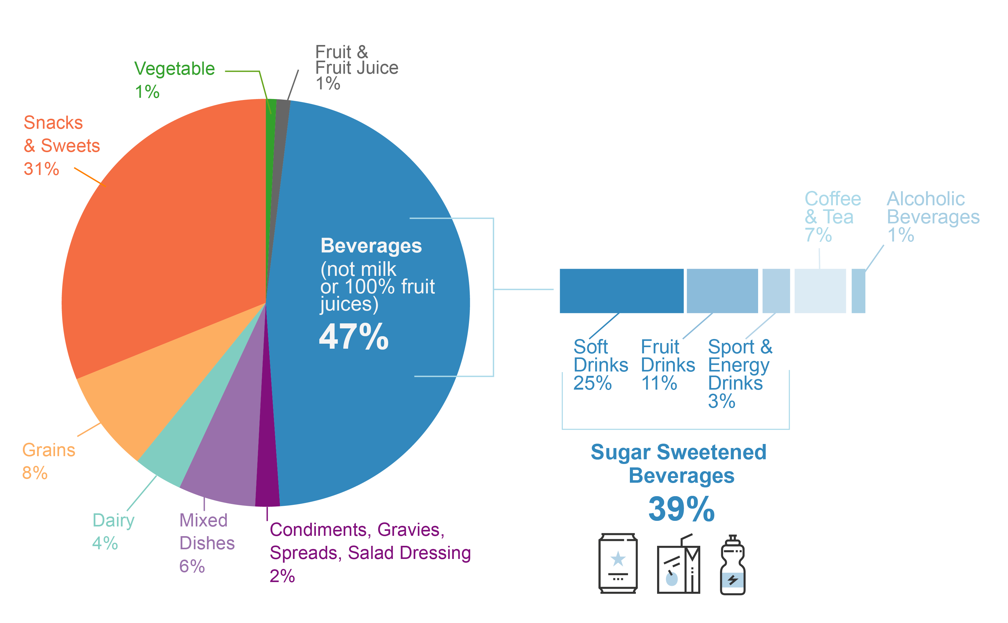
Why focus on SSBs?
Source: NHANES 2009-2010.
Notes:
-largest source of added sugar in our diet
Empty calories with no nutritional value
Easily modifiable
-From public health perspective – key strategy for reducing prevalence of obesity in the population – stop weight gain in first place

Slide 23
Source: Why Sugar is Not So Sweet

Slide 24
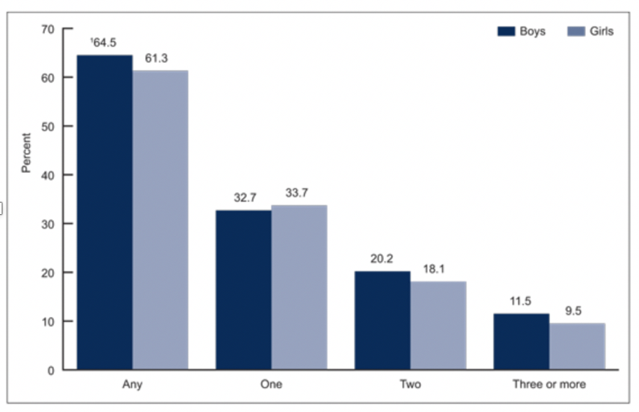
Daily SSB Consumption among 2-19 y/o
BOYS
GIRLS
Source: NHANES, National Health and Nutrition Examination Survey 2011-2014

Slide 25

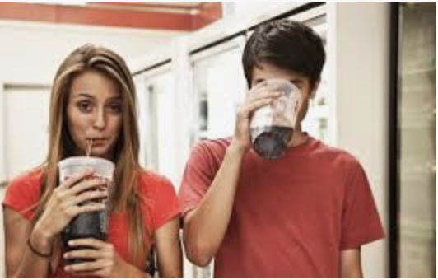
SSB Consumption increases from early childhood through adolescence
4.4% of 2-5 year-olds drink >2 SSB/day
20-30% of 12-17 year-olds drink >2 SSB/day
Rosinger A et al. Sugar-sweetened beverage consumption among U.S. youth, 2011–2014.
NCHS Data Brief. No 271. Hyattsville, MD: National Center for Health Statistics. 2017
Notes:
5. Rosinger A, Herrick K, Gahche J, Park S. Sugar-sweetened beverage consumption among U.S. youth, 2011–2014. NCHS Data Brief. No 271. Hyattsville, MD: National Center for Health Statistics. 2017.

Slide 26
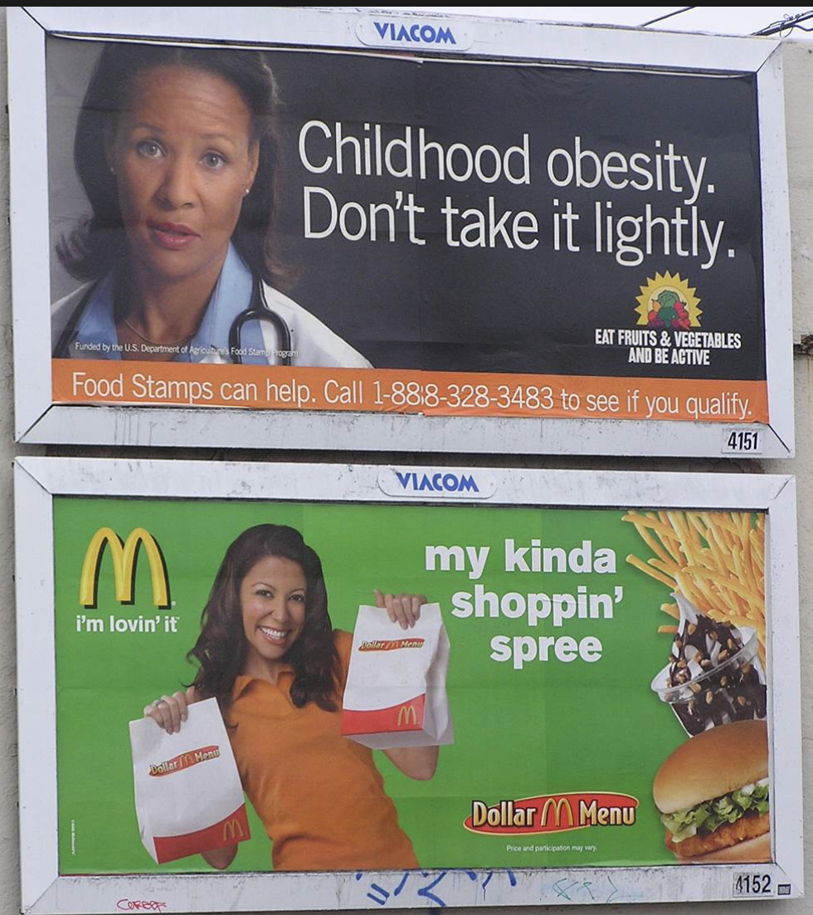
Health Disparities
Low-income communities and people of color
Disproportionate 1) exposure to and 2) consumption of SSB
Driven by
  financial disparities
  targeted advertising
Contributes to poorer health outcomes in these groups
Source: Rudd Report (2015) University of Connecticut, Drexel University, University of Texas Health Science Center

Slide 27
How much is too much?
Organization | Daily maximum added sugar recommendation
USDA | <10% of caloric intake = 48g/45g
AHA | W and C: 100 calories = 24 grams M: 150 calories = 36 grams
WHO | <10% of caloric intake 48/45g <5% reduce “non-communicable diseases” 24/22g

Slide 28

Maximum
Daily Recommended
Added Sugar

Slide 29




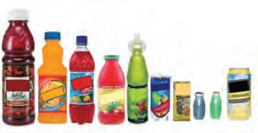
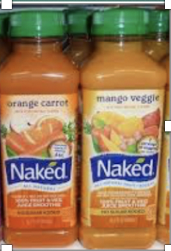

More than 24 grams of added sugars hide in single servings of:
Sodas
Flavored Waters
Iced Teas
Sports/
Energy Drinks
Fruit Juice/
Lemonade
Smoothies
Notes:
Soda commonly thought of as main sugar-sweetened beverage
Many people are not aware of how much sugar hides in their drinks

Slide 30
Hidden Sugar
brown sugar
corn sweetener
corn syrup
dextrose
fructose
glucose
high-fructose corn syrup
honey
lactose
malt syrup
maltose
molasses
raw sugar
sucrose
Notes:
-same effect on the body regardless of the type of sugar

Slide 31
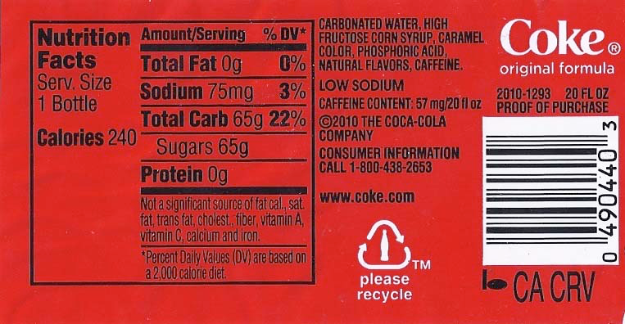
1) Find the grams of sugar
65 grams of sugar!
3 DAYS!

Slide 32
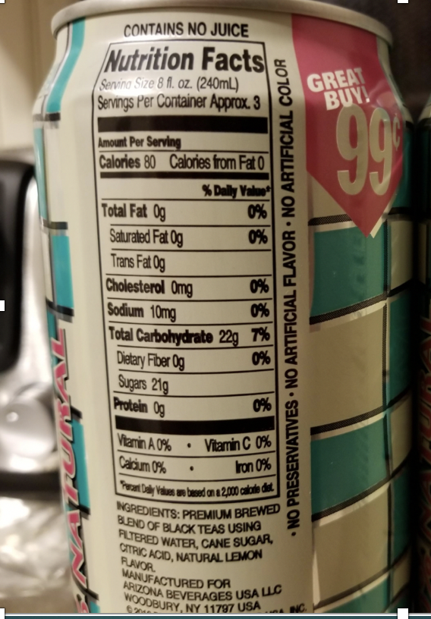
2)Find the Serving Size

Slide 33
Sugar Show Label Review
Notes:
-Pass out bottles have already and have people review how much sugar is in each item

Slide 34
Water Best Beverage Choice
Make water available during entire program
Promote drinking water by:
  Using fruit-infused pitchers
  Having students decorate re-usable cups
  Serving herbal tea during winter
  Experiment with different ice cubes – shape and flavors!
Notes:
- Water should be made available to students at all times

Slide 35
Staff Wellness
Practice what you preach!
Re-vamp meetings
Move more
De-stress
Notes:
Alliance website – pull resources from here for one-pager for everyone

Slide 36
Action Planning

Slide 37

Kristi Burry, MPH, CHES, CPH
Manager, Health and Prevention, Community Health
UPMC Children’s Hospital of Pittsburgh
Kristi.burry@upmc.edu

