Slide 1
While you are waiting, think about:
What challenges are you facing in terms of getting your youth outside?

Slide 2
Engaging kids outside
Notes:
introductions

Slide 3
POLL: Who are you here as?
Youth worker who will be teaching virtually
Youth worker who will be teaching in person
Parent
Other
Notes:
PRACTICE BEFOREHAND

Slide 4
Webinar Norms
If you are not talking, please mute yourself.
Share out ideas, successes, challenges, anything!
Questions? Unmute yourself at any time or ask in the chat box.
We are recording this session to post on our website.
We will email you these resources after.

Slide 5
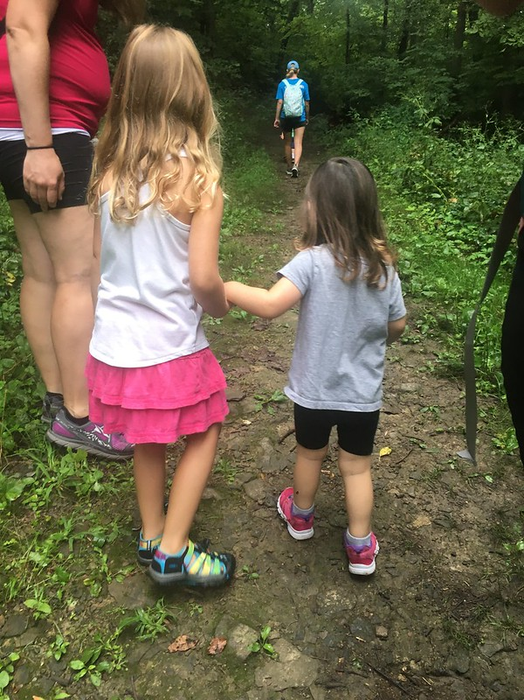
Agenda
Virtual Outdoor Experiences
3 apps to use outside
2 easy activities
Please use appropriate social distancing
guidelines as instructed by local authorities.

Slide 6
What challenges are you facing?
Click on drop down menu “View Options” at the top of your screen.
Select “Annotate”
Select “Text”
Write response directly on the slide.

Slide 7
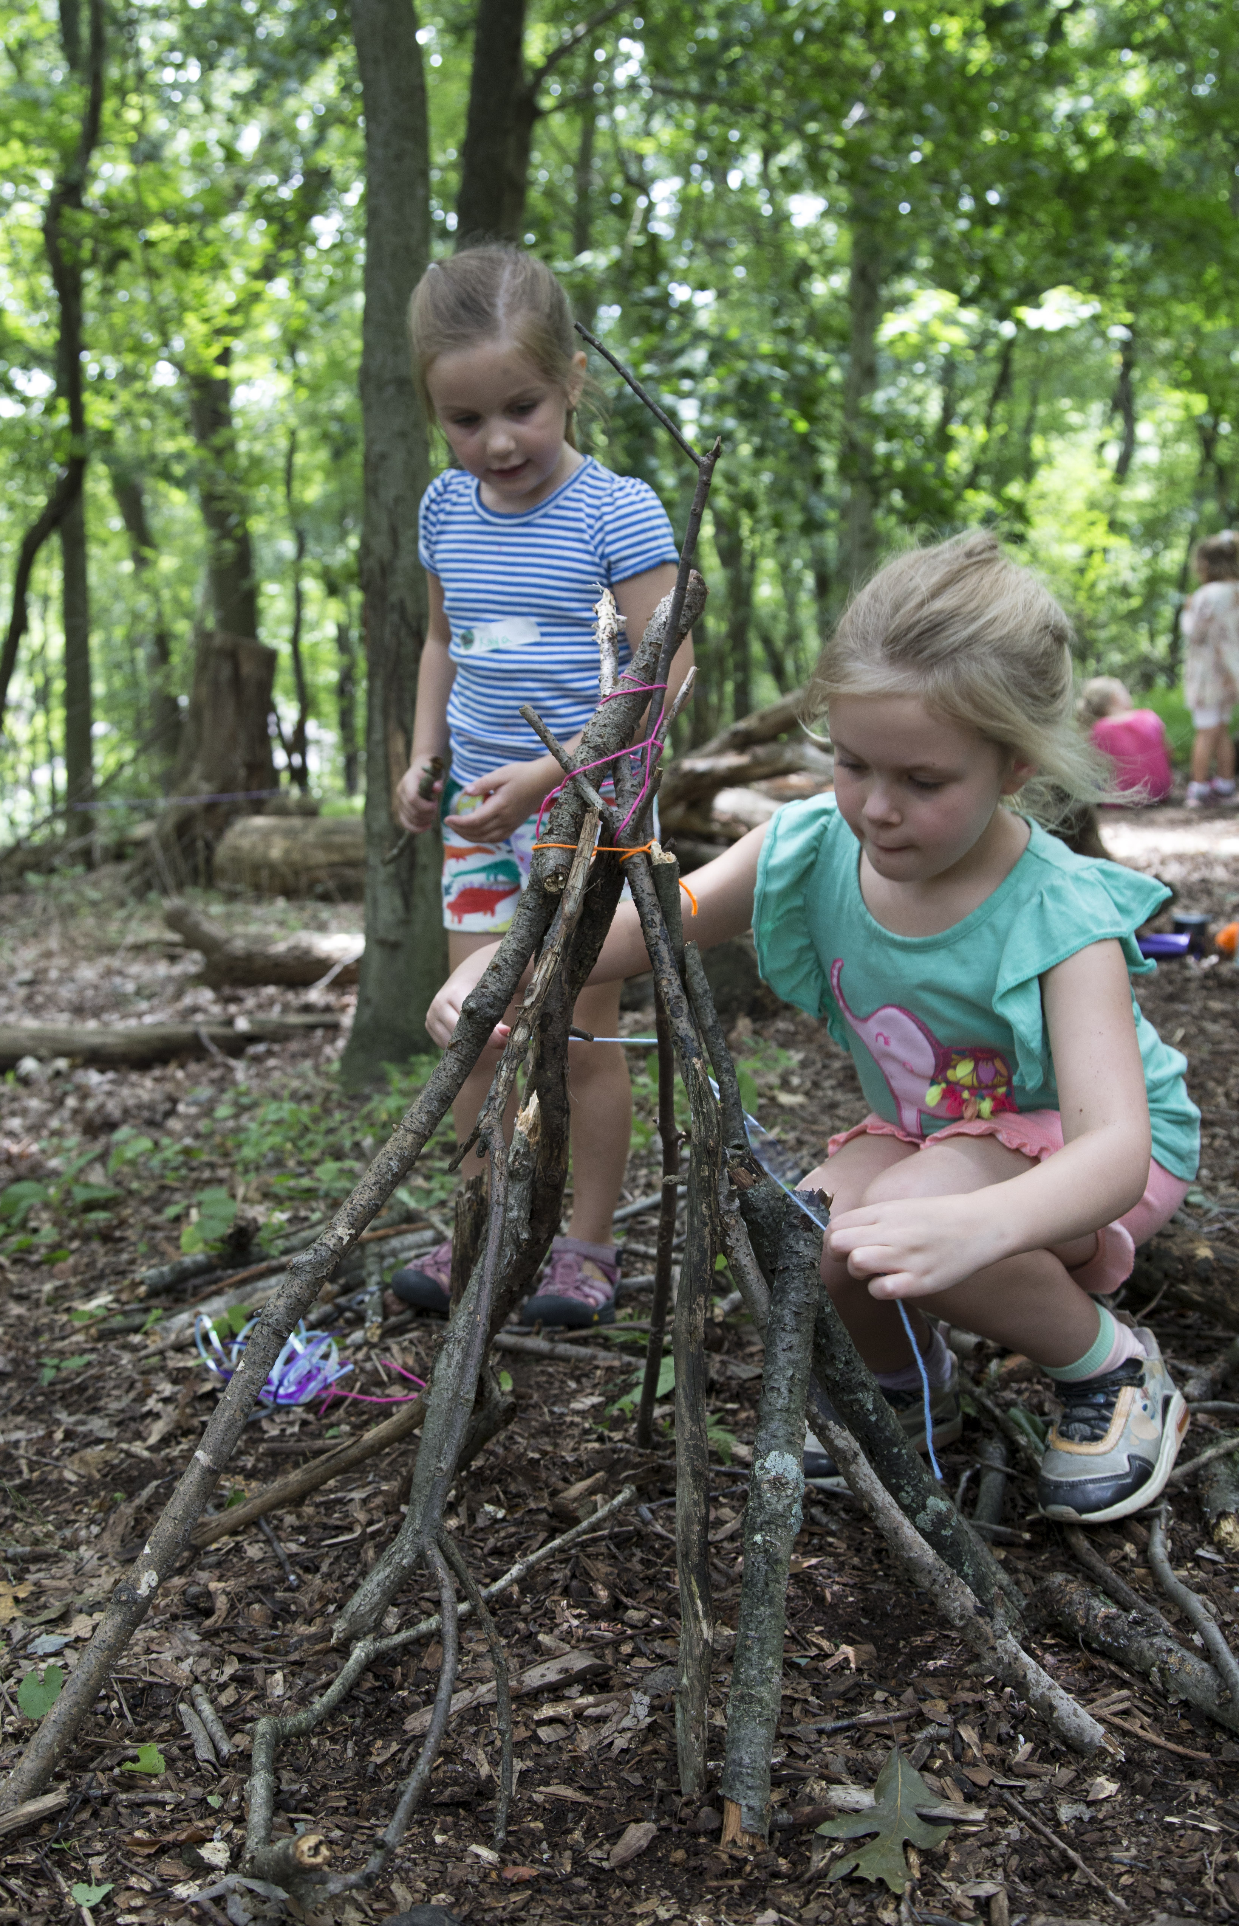
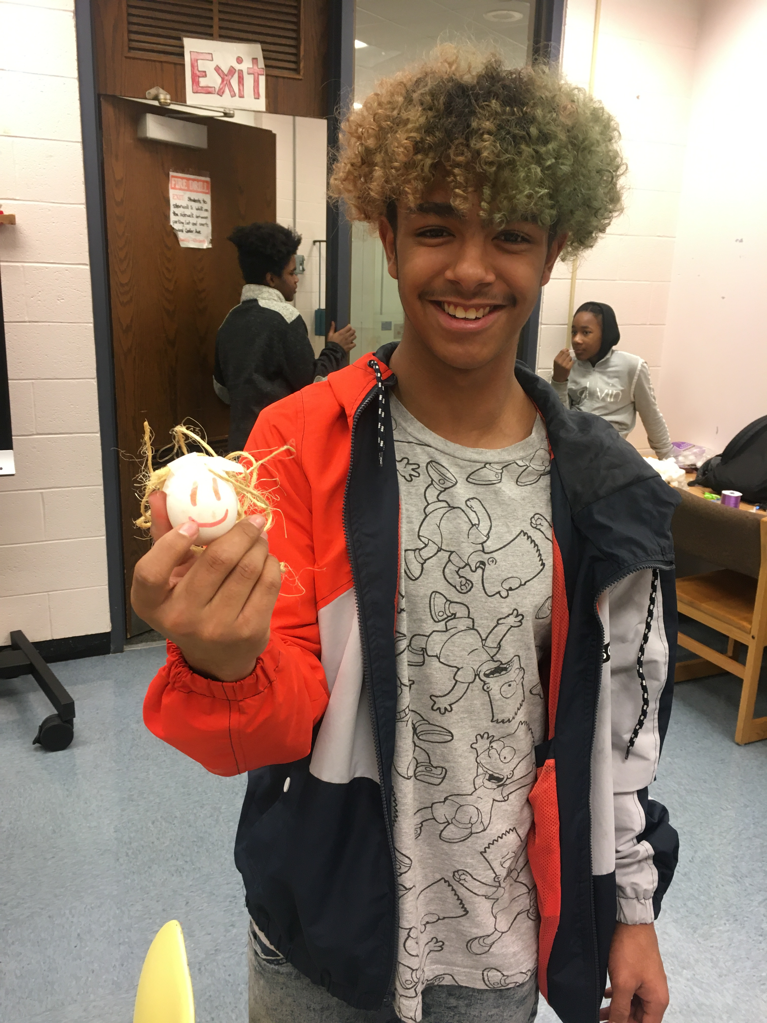
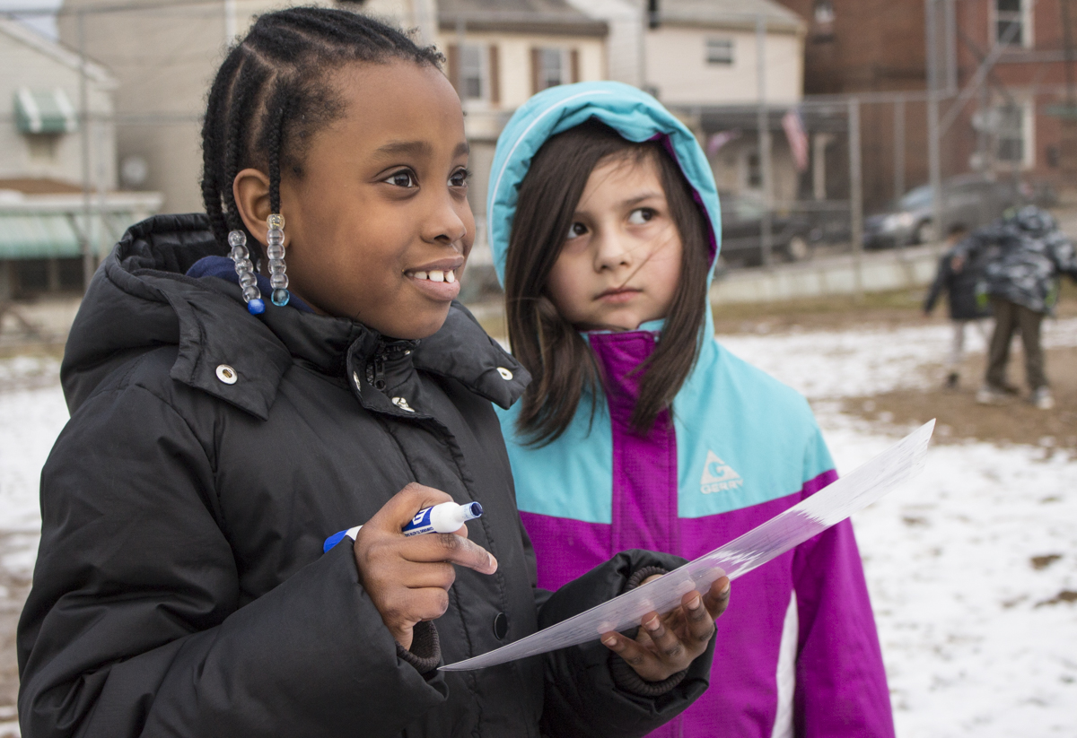
Importance of Getting Outside
Notes:
Facts:
Youth spend only 4-7 minutes of free play outside each day
Time outside boosts the immune system
Decreases stress
Increases attention span
SO MANY MORE

Slide 8
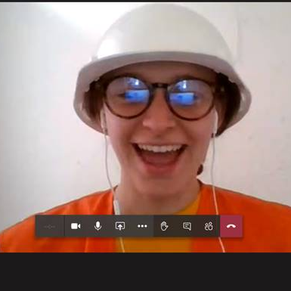
Incentives!
Keep track of who virtually engages the most to earn something special
Students earn prizes for completing each activity
Notes:
Tracking incentives virtually

Slide 9
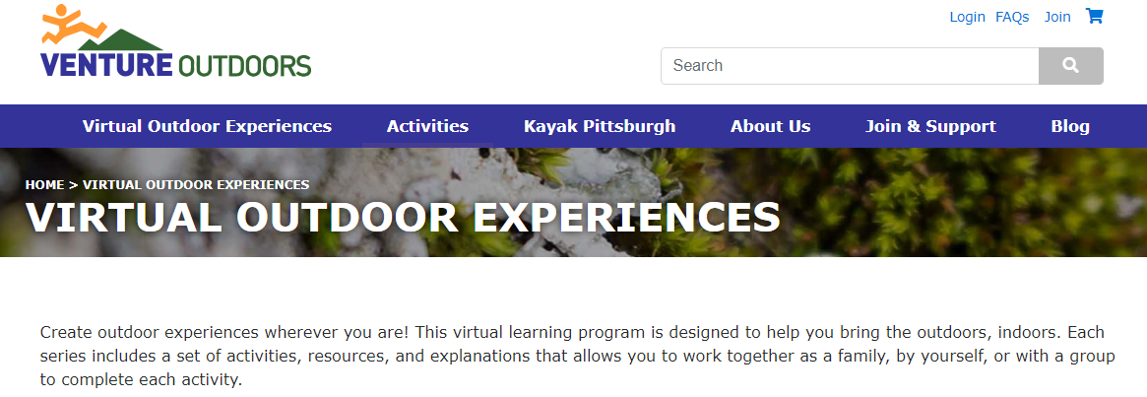
Virtual Outdoor Experiences
https://www.ventureoutdoors.org/virtual-outdoor-experiences/

Slide 10
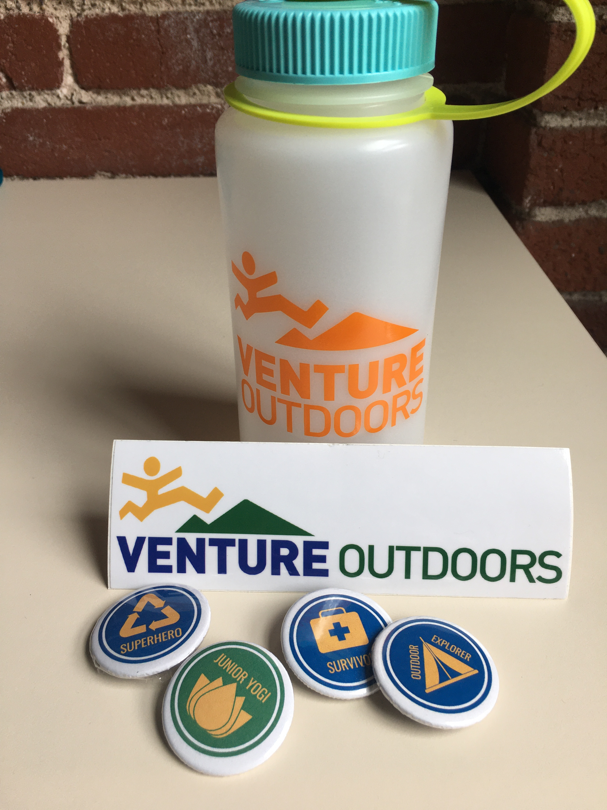
Virtual Outdoor Experiences
Different Series
Youth Explorer Button Series
Youth Outdoor Leadership Series
Youth Nature Running Series w. Kids of STEEL
Parent Webinars
Outdoor Activities for youth
Notes:
Recap and questions

Slide 11
Apps to Use Outdoors
Geocaching.com
iNaturalist
Skyview
Notes:
Inevitable connection between technology and nature

Slide 12
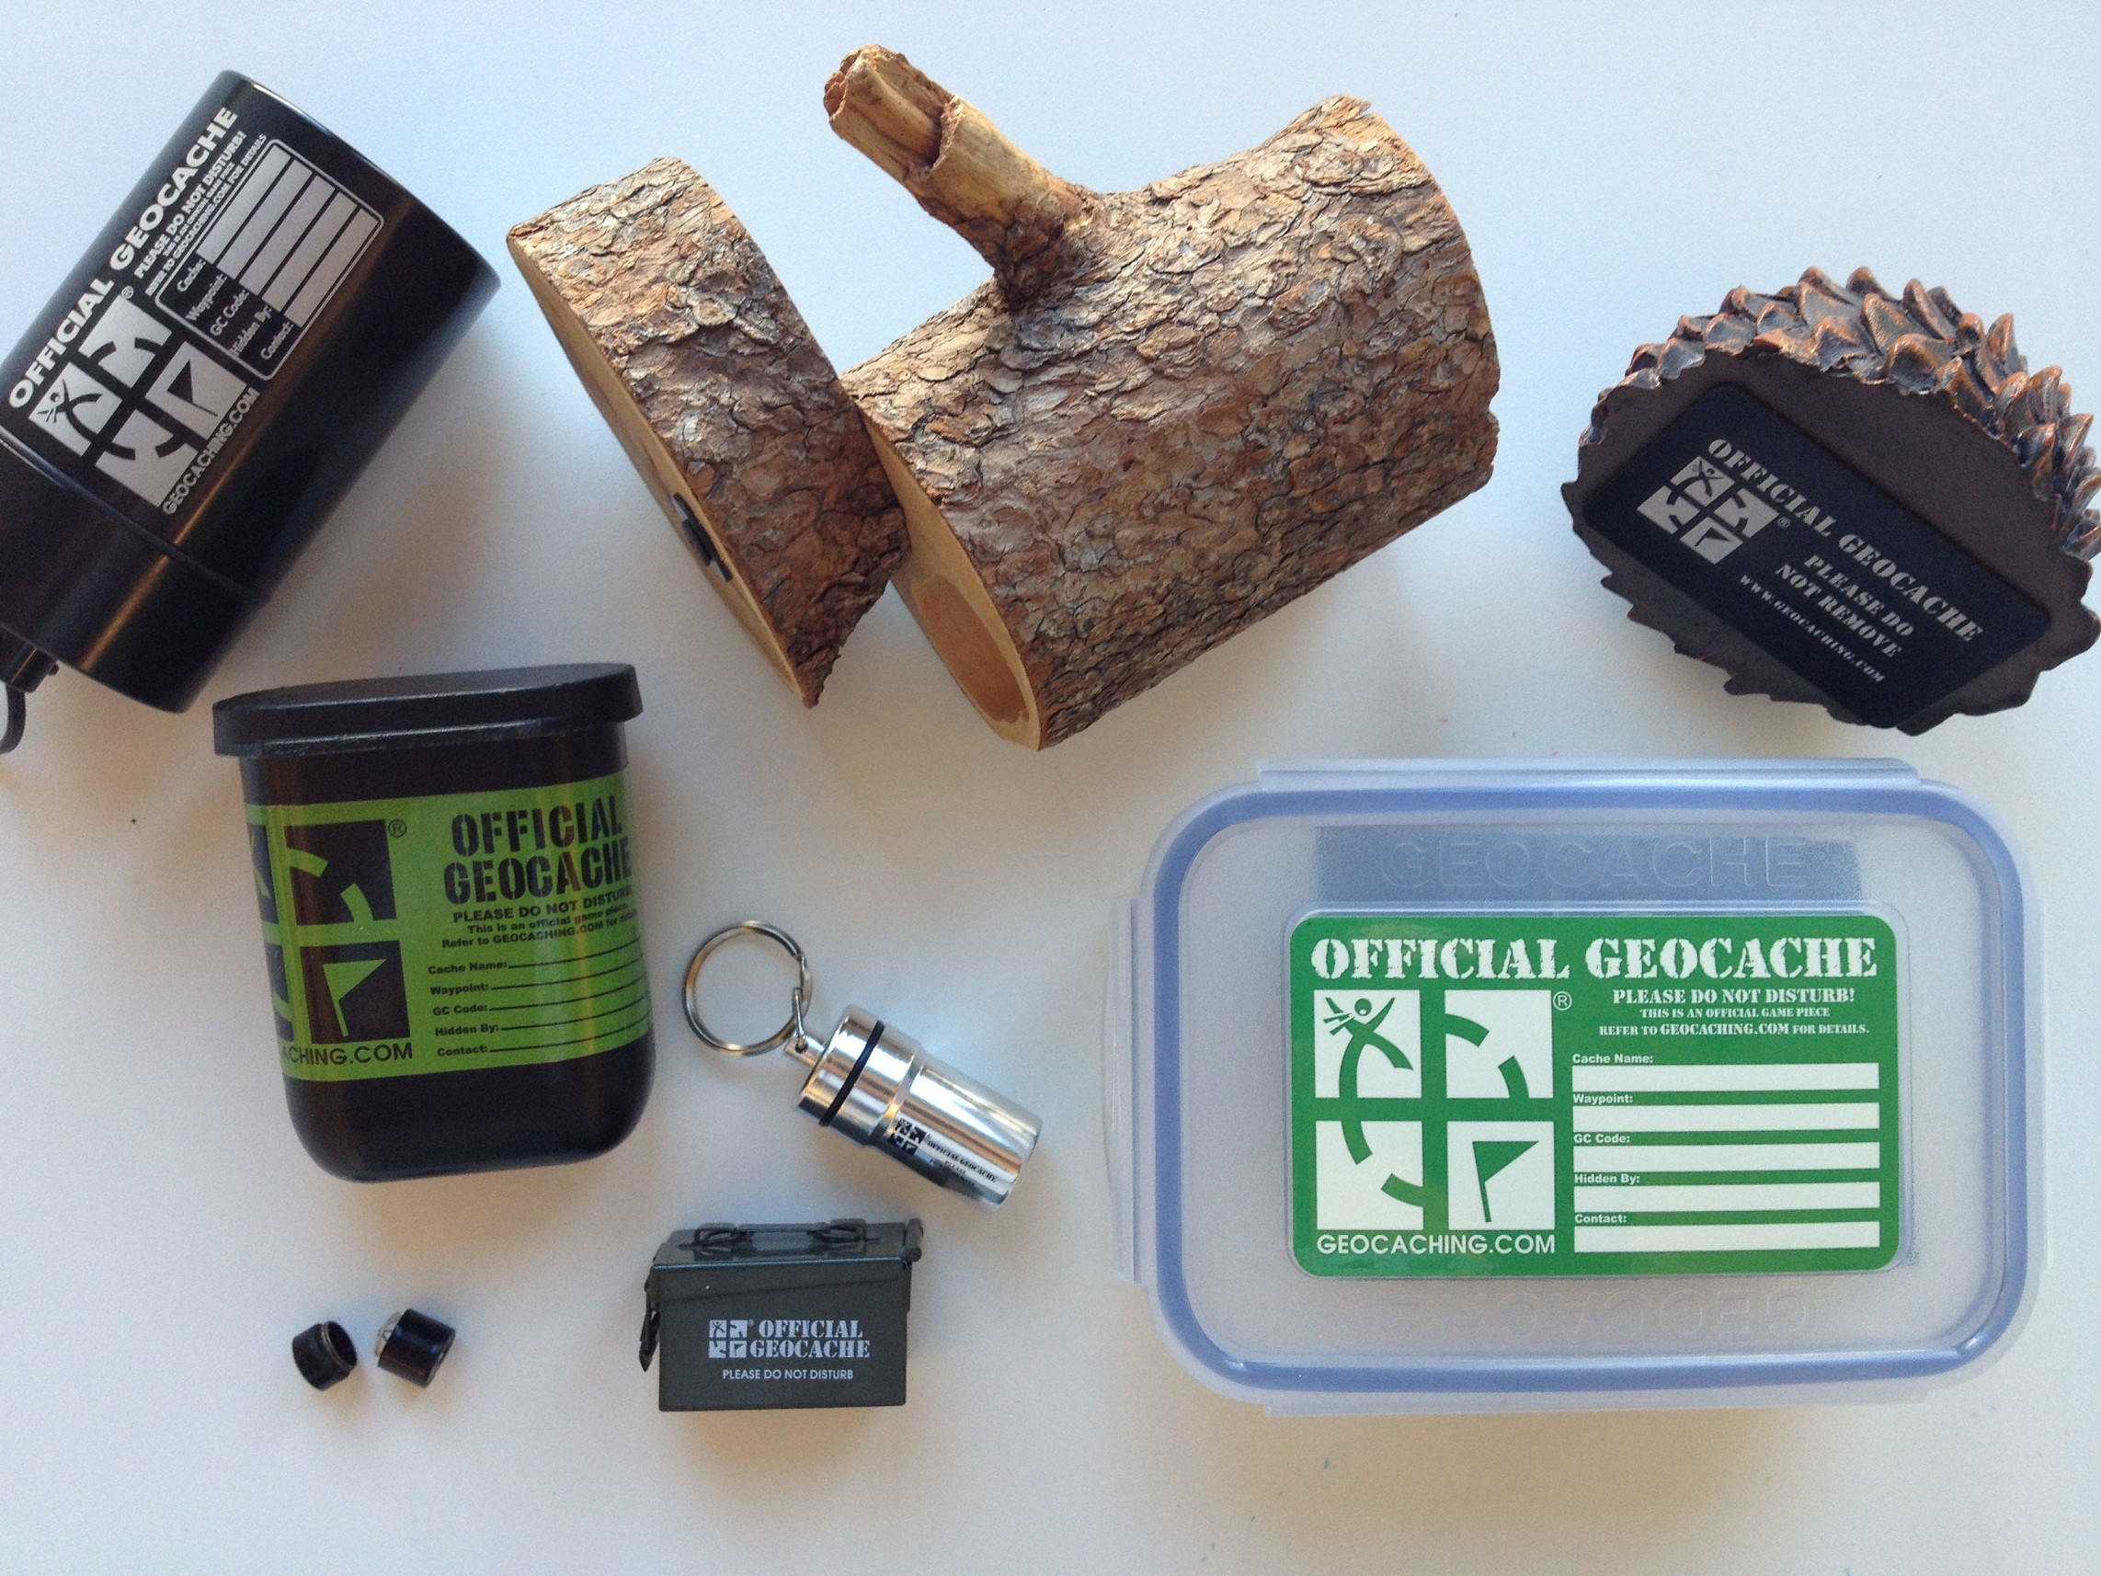
Geocaching.com
Geocaching is global activity
Find “caches,” or hidden containers
Use GPS coordinates

Slide 13
Geocaching.com

Slide 14
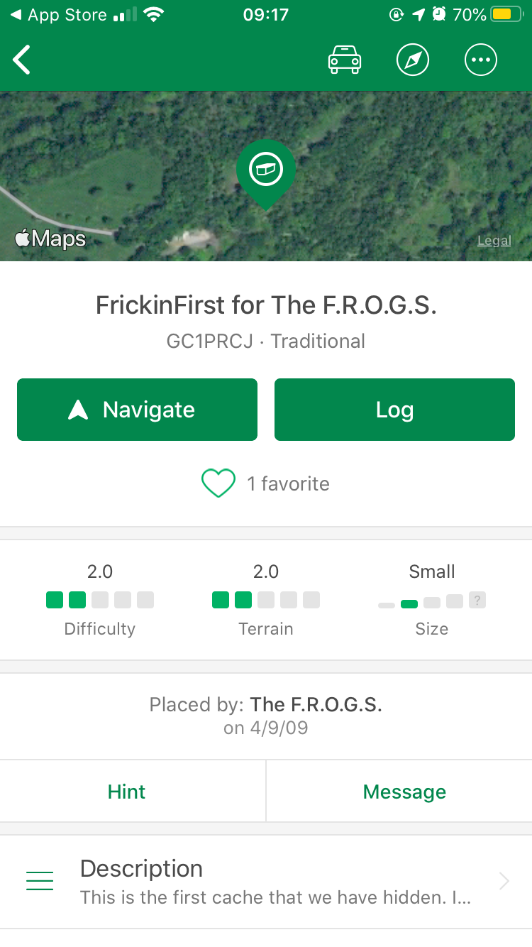
Geocaching.com

Slide 15
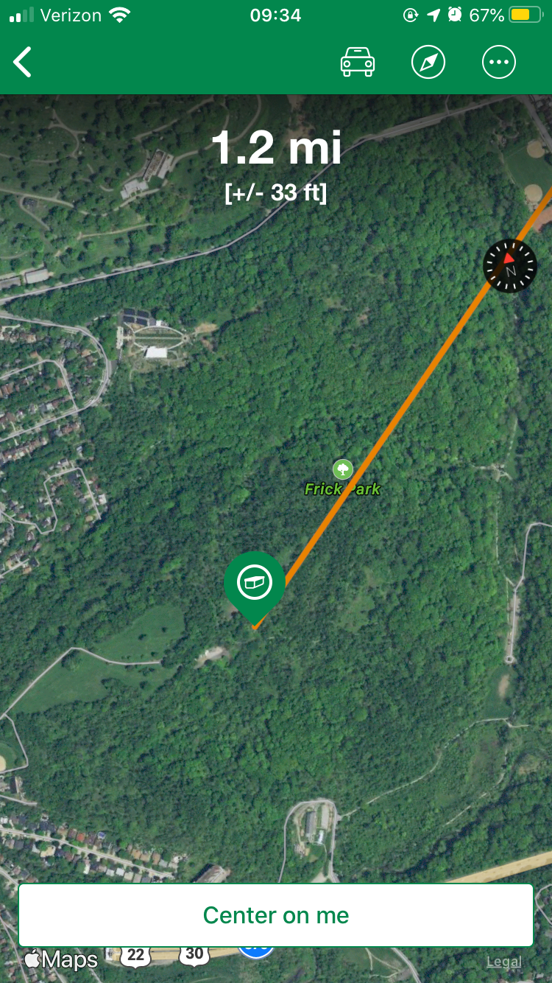
Geocaching.com

Slide 16
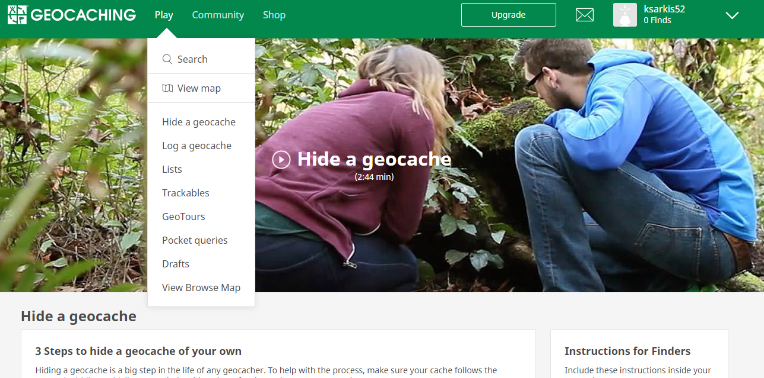
Geocaching.com

Slide 17
iNaturalist
Species identification
Citizen Science Project
Two parts
Observe
Identify
iNaturalist Info
Notes:
Ages: older youth (11+)
Look for alternative for younger kids (plum)

Slide 18
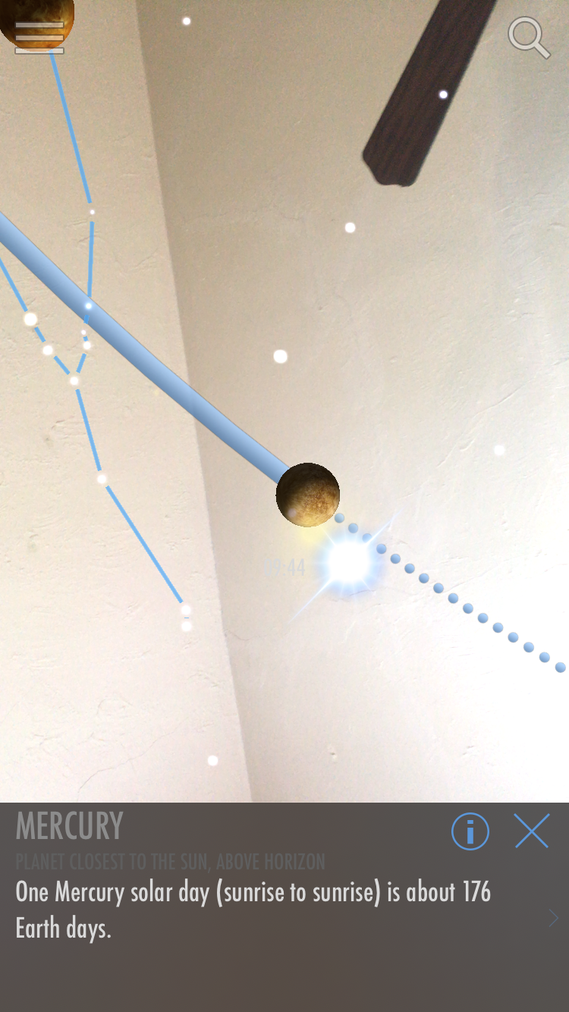
Skyview (Lite)
Notes:
Questions about any of the apps?

Slide 19
Poll: Which of these will you most likely use with your youth this summer?
iNaturalist
Skyview
Geocaching.com
Notes:
Here or after apps? Or all thing

Slide 20
Family Activities
Nature Bingo
Nature Art

Slide 21
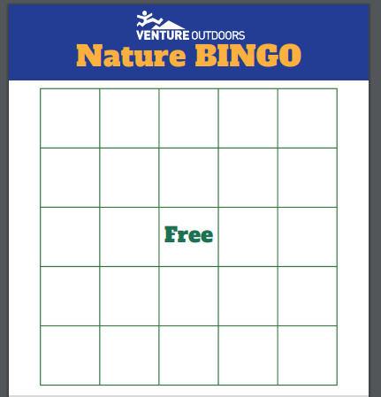
Let’s Play Nature Bingo!
Notes:
Different ways to play:
Images of things in natures
Letters- find things that start with
Senses- Hear a bird, etc.

Slide 22
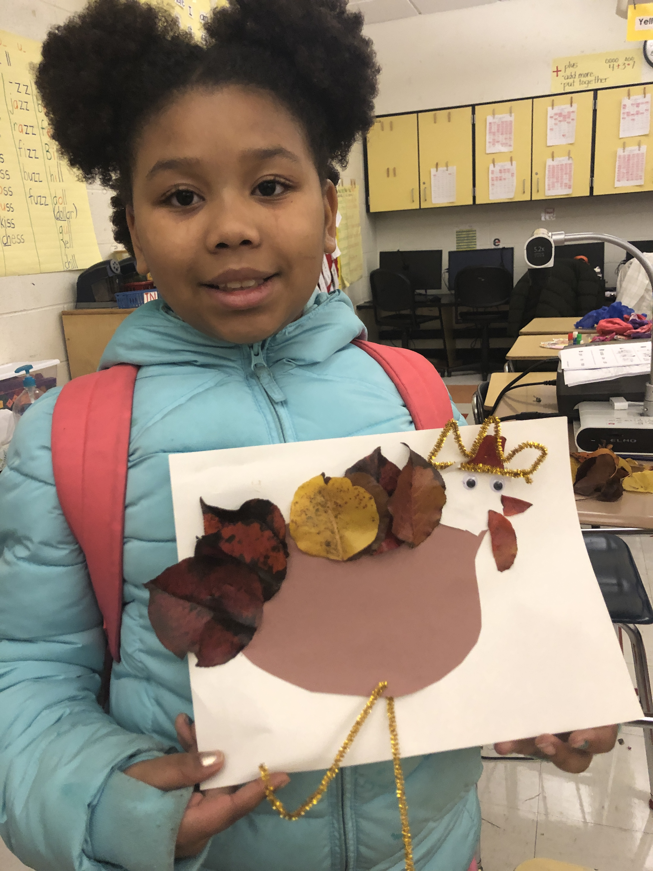
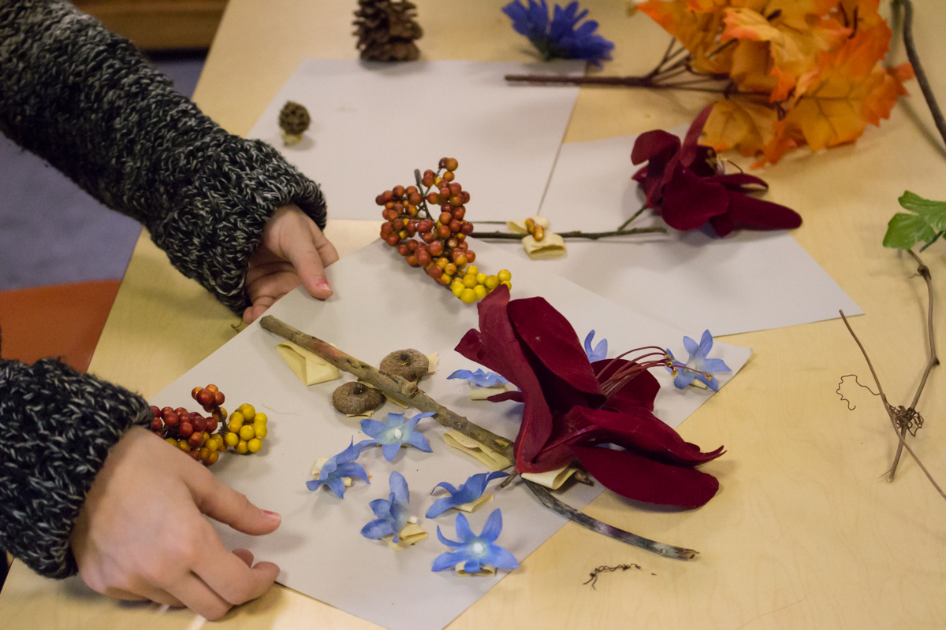
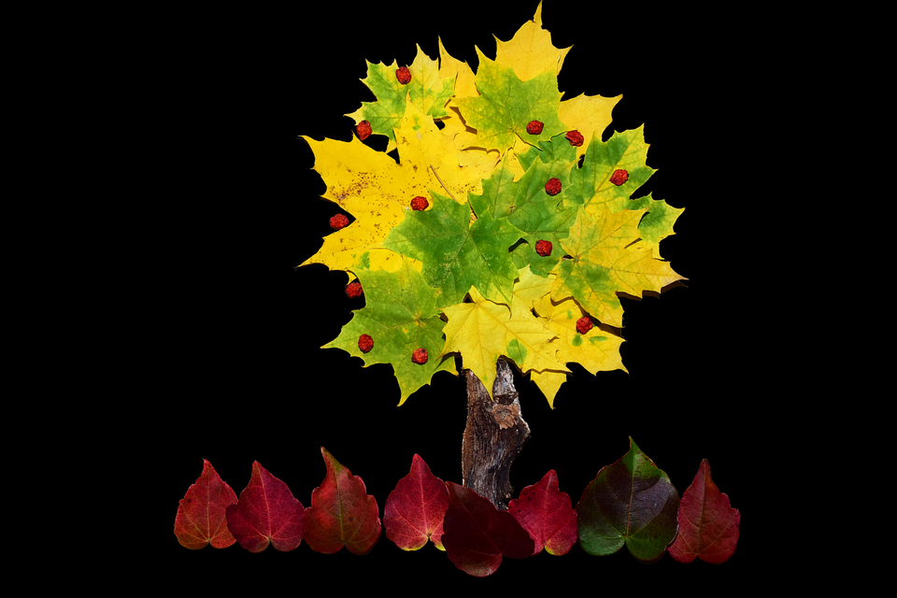
Nature Art
If you see 100 leaves, it’s ok to take 1, as long as its dead.
Notes:
Cheap flowers at dollar store

Slide 23
Beatboxing! Pick a number from 1-5
First: 4
Second: 3
Third: 3
Fourth: 2
Note: You may want to decrease the volume on your computer, as this app may be loud.
Incredibox.com

Slide 24
Additional Resources
Virtual Outdoor Experiences
Apps:
iNaturalist
Geocaching.com
Skyview Lite (iPhone or Android)
Outdoor Family Fun with Plum
Contact Info:
Kelly Sarkis: Kelly@ventureoutdoors.org
Lo Zemanek: Lo@ventureoutdoors.org
Notes:
Will email you these documents after

Slide 25
Questions?
Notes:
EDIT PRIOR TO START

